Slide 1
Chapter 1 An Introduction to Computer Science
1
Notes:
- Ask students for their intuitive description of the field of computer science?

Slide 2
Introduction
Misconceptions
Computer science is:
The study of computers
The study of how to write computer programs
The study of the uses and applications of computers and software
Notes:
- Introduce the term algorithm, and discuss everyday examples of algorithms: recipes, driving directions, instruction manuals, etc.

Slide 3
The Definition of Computer Science
Computer science is the study of algorithms, including:
Their formal and mathematical properties
Their hardware realizations
Their linguistic realizations
Their applications
Abu Ja’far Muhammad ibn Musa Al-Khowarizmi (AD 780-850?), Persian Author
Notes:
Gibbs and Tucker definition says that it is the task of the computer scientist to design and develop algorithms to solve a range of important problems.
- Abu Ja’far Muhammad ibn Musa Al-Khowarizmi (AD 780-850?), Khiva, Ujbekistan
Abu Jafar Mohammed ibn Musa al Khowarizmi (825 AD)
wrote a Math textbook
al Khowarizmi: from the town of Khowarazm (now Khiva, Uzbekistan)

Slide 4
The Definition of Computer Science (continued)
Algorithm
Informally, “an ordered sequence of instructions that is guaranteed to solve a specific problem.”
Operations used to construct algorithms
Sequential operations
Conditional operations
Iterative operations
Notes:
37 + 56 = ?

Slide 5
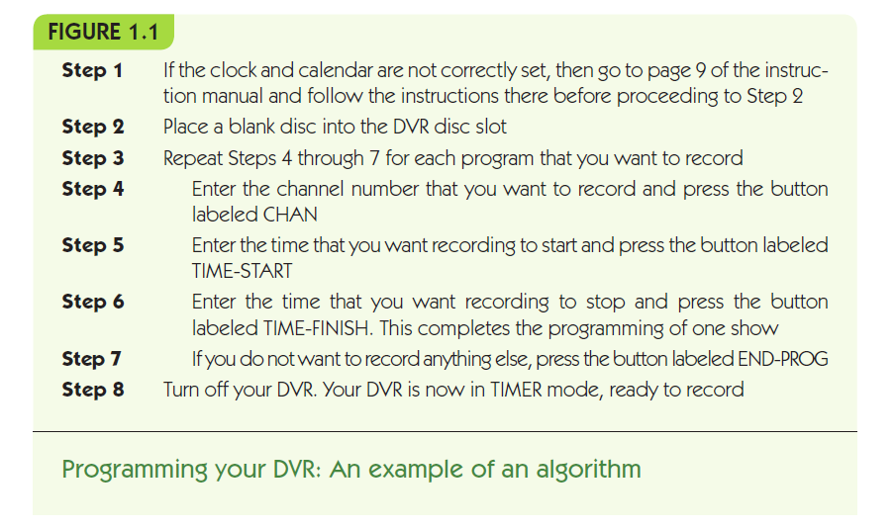

Slide 6
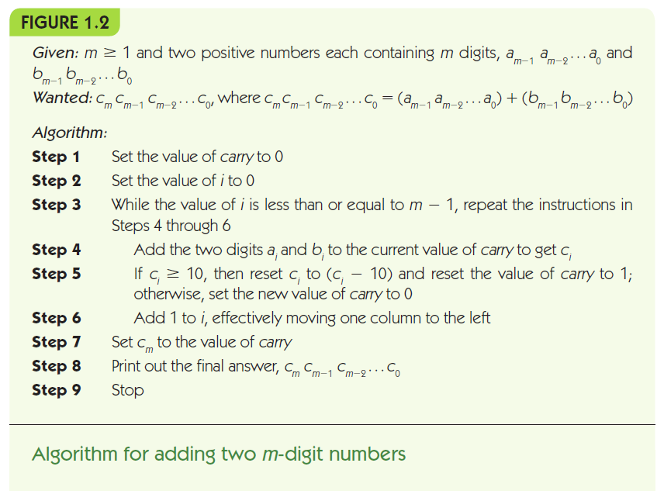
Notes:
Work out 37 + 56 = ?
m = 2

Slide 7
The Definition of Computer Science (continued)
Why are formal algorithms so important in computer science?
If we can specify an algorithm to solve a problem, then we can automate its solution
Computing agent
Machine, robot, person, or thing carrying out the steps of the algorithm
Unsolved problems
Some problems are unsolvable, some solutions are too slow, and some solutions are not yet known
Notes:
German logician Kurt Gödel in the early 1930s – unsolvable, undecidable problem
HALTING problem
partition two sets of arbitrary integers - NP complete

Slide 8
Algorithms
The Formal Definition of an Algorithm
A well-ordered collection of unambiguous and effectively computable operations that, when executed, produces a result and halts in a finite amount of time
Shampooing instructions:
STEP 1 Wet hair
STEP 2 Lather
STEP 3 Rinse
STEP 4 Repeat
Notes:
each step may be done in parallel if no dependencies
An algorithm is composed of a finite number of steps, each of which may require one or more operations.
- each OPERATION executable on a computer.
- compute 5/0 is not WELL DEFINED.
- algorithms must TERMINATE after a finite number of operations.
PROCEDURE: a nonterminating algorithm. e.g. OS.

Slide 9
Algorithms (continued)
Well-ordered collection
Upon completion of an operation we always know which operation to do next
Ambiguous statements
Go back and do it again (Do what again?)
Start over (From where?)
Notes:
Ambiguous: Take a simple example, and rewrite it for an adult expert, an average adult, a 12-year old, and a 5-year old.
Draw a square

Slide 10
Algorithms (continued)
Unambiguous operation, or primitive
Can be understood by the computing agent without having to be further defined or simplified
It is not enough for an operation to be understandable
It must also be doable (effectively computable) by the computing agent
Finding 100th Prime Number?
STEP 1 Generate a list L of all the prime numbers: L₁, L₂, L₃,…
STEP 2 Sort the list L in ascending order
STEP 3 Print out the 100th element in the list, L₁₀₀
STEP 4 Stop
Notes:
effectively computable
If an algorithm tells me to flap my arms really quickly and fly, I understand perfectly well what it is asking me to do. However, I am incapable of doing it.
Divide by 0, undefined number I + 1

Slide 11
Algorithms (continued)
Algorithm
Result must be produced after the execution of a finite number of operations
Result may be a number, text, a light, picture, sound, or a change in the computing agent’s environment
Infinite loop
Runs forever
Usually a mistake
Notes:
OS is not an algorithm technically.

Slide 12
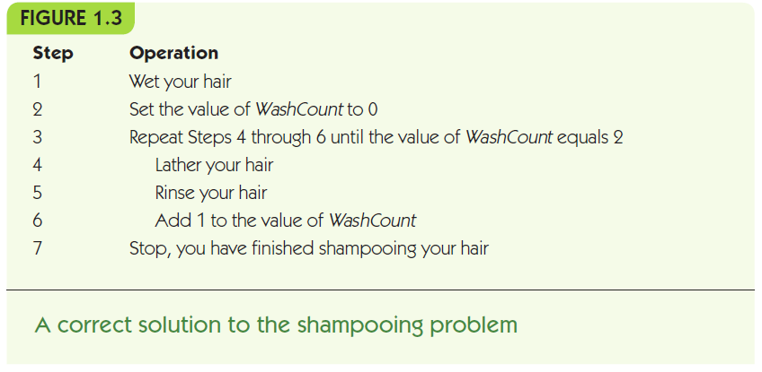

Slide 13
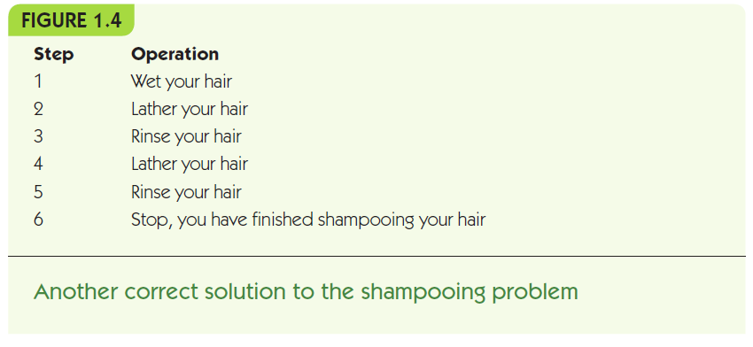

Slide 14
Algorithms (continued)
The Importance of Algorithmic Problem Solving
“Industrial revolution” of 19th century
Mechanized and automated repetitive physical tasks
“Computer revolution” of the 20th and 21st centuries
Mechanized and automated repetitive mental tasks
Through algorithms and computer hardware

Slide 15
Quick Quiz 1
1. Which kind of operation is “Add water until the cup is full”?
2. (True or false) All algorithms are known, computer scientists simply select the correct algorithm for each new problem.
3. Operations that a given computing agent can perform are called ______________.
4. List at least two flaws in the “algorithm” below.
Given a jar full of jelly beans,
Pick a jelly bean from the jar
Add one to the total count
Repeat until the jar is empty

Slide 16
Food for Thought - Practice Problems
Get a copy of the instructions that describe how to do the following and decide if they are algorithms
Register for classes at the beginning of the semester.
Use the online computer catalog to see what is available in the college library on a given subject.
Use the copying machine in your building.
Log on to the World Wide Web.
Add someone as a friend to your Facebook account.

Slide 17
A Brief History of Computing The Early Period: Up to 1940
Seventeenth century: automation/simplification of arithmetic for scientific research
John Napier invented logarithms as a way to simplify difficult mathematical computations (1614)
The first slide rule appeared around 1622
Blaise Pascal designed and built a mechanical calculator named the Pascaline (1672)
Gottfried Leibnitz constructed a mechanical calculator called Leibnitz’s Wheel (1674)
Notes:
Greeks developed the fields of geometry and logic; the Babylonians and Egyptians developed numerical methods for generating square roots, multiplication tables, and trigonometric tables used by early sailors; Indian mathematicians developed both the base-10 decimal numbering system and the concept of zero; and in the ninth century, the Persians developed algorithmic problem solving

Slide 18
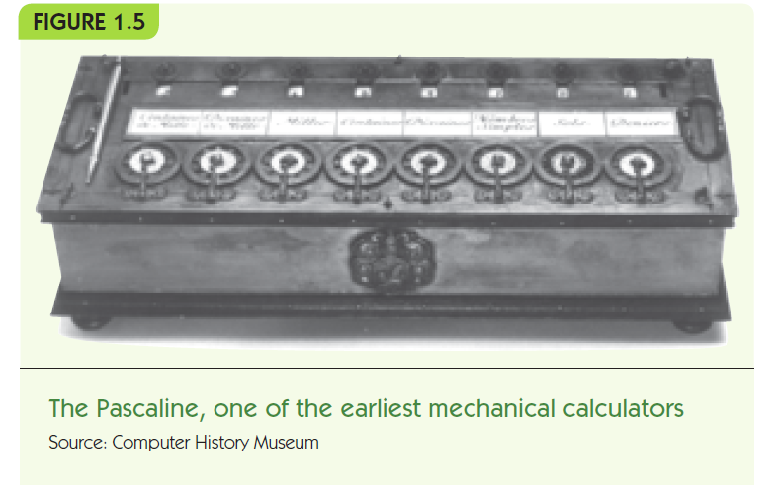

Slide 19
A Brief History of Computing The Early Period: Up to 1940 (continued)
Seventeenth century devices
Could represent numbers
Could perform arithmetic operations on numbers
Did not have a memory to store information
Were not programmable (a user could not provide a sequence of actions to be executed by the device)

Slide 20
A Brief History of Computing The Early Period: Up to 1940 (continued)
Nineteenth century devices
Joseph Jacquard designed an automated loom that used punched cards to create patterns (1801)
Herman Hollerith (1880s on)
Designed programmable card-processing machines to read, tally, and sort data on punched cards for the U.S. Census Bureau
Founded company that became IBM in 1924
Computer Tabulating Recording Company -> IBM
Notes:
Whereas the 1880 census required 8 years to be completed, the 1890 census was finished in about 2 years, even though there was a 30% increase in the U.S. population during that decade.
His punched card machines became the dominant form of data-processing equipment during the first half of the twentieth century, well into the 1950s and 1960s.

Slide 21
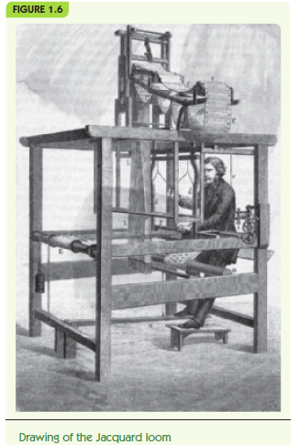

Slide 22
A Brief History of Computing The Early Period: Up to 1940 (continued)
Charles Babbage
Difference Engine designed and built in 1823
Could do addition, subtraction, multiplication, and division to six significant digits
Could solve polynomial equations and other complex mathematical problems
Analytical Engine, designed but never built
Mechanical, programmable machine similar to a modern computer
Notes:
Worked with Ada Lovelace

Slide 23
A Brief History of Computing The Early Period: Up to 1940 (continued)
Babbage’s Term Modern Terminology
mill arithmetic/logic unit
store memory
operator processor
output unit input/output
Ada Augusta Byron – First programmer
Notes:
Worked with Countess Ada Augusta Byron, daughter of the famous English poet, Lord Byron
Babbage died in 1871 without realizing his dream.
He also died quite poor because the Analytic Engine ate up virtually all of his personal fortune.

Slide 24
A Brief History of Computing The Early Period: Up to 1940 (continued)
Nineteenth century devices
Were mechanical, not electrical
Had many features of modern computers:
Representation of numbers or other data
Operations to manipulate the data
Memory to store values in a machine-readable form
Programmable: sequences of instructions could be pre-designed for complex operations

Slide 25
A Brief History of Computing The Birth of Computers: 1940–1950
ABC system (Atanasoff-Berry Computer) (1942)
Mark I (1944)
Electromechanical computer used a mix of relays, magnets, and gears to process and store data (binary, memory 72, * 4 s )
Colossus (1943)
General-purpose computer built by Alan Turing for British Enigma project - German Enigma code
ENIAC (Electronic Numerical Integrator and Calculator) (1946) - Eckert and Mauchly
First publicly known fully electronic computer
Firing tables, 18k tubes, 100X10’, 30 ton, * 4 ms)
Notes:
Beginning in 1931, the U.S. Navy and IBM jointly funded a project at Harvard University under Professor Howard Aiken to build a computing device called Mark I.
The Mark I had a memory capacity of 72 numbers, and it could be programmed to perform a 23-digit multiplication in the lightning-like time of 4 seconds.
Eniac - firing tables were taking more time to construct than the gun itself—a skilled person with a desk calculator required about 20 hours to analyze a single 60-second trajectory

Slide 26
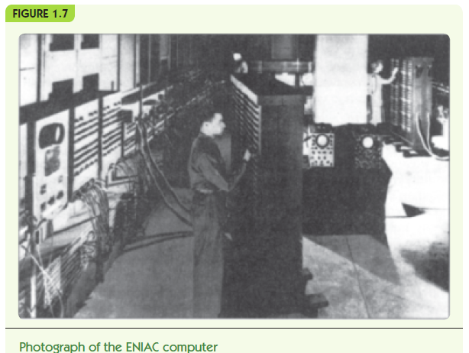
Notes:
ABC system (Atanasoff-Berry Computer) designed and built by Professor John Atanasoff and his graduate student Clifford Berry at Iowa State University, was actually the first electronic computer, constructed during the period 1939–1942. However, it never received equal recognition because it was useful for only one task, solving systems of simultaneous linear equations.

Slide 27
A Brief History of Computing The Birth of Computers: 1940–1950 (continued)
John Von Neumann
Proposed a radically different computer design based on a model called the stored program computer
Research group at the University of Pennsylvania built one of the first stored program computers, called EDVAC, in 1951
UNIVAC-1, a version of EDVAC, first commercially-sold computer – Echert/ Mauckley
Virtually all modern computers use the Von Neumann architecture
Notes:
Von Neumann proposed that the instructions that control the operation of the computer be encoded as binary values and stored internally in the memory unit along with the data.
A commercial model of the EDVAC, called UNIVAC I—the first computer actually sold—was built by Eckert and Mauchly and delivered to the U.S. Bureau of the Census on March 31, 1951.
In February 1964, the Sperry Rand Corp. (now UNISYS) was granted a U.S. patent on the ENIAC computer as the first fully electronic computing device, J. Presper Eckert and John Mauchly being its designers and builders. However, in 1967 a suit was filed in U.S. District Court in Minneapolis, Minnesota, to overturn that patent.
On November 13, 1990, in a formal ceremony at the White House, Professor Atanasoff was awarded the National Medal of Technology by President George H. W. Bush for his pioneering contributions to the development of the computer.

Slide 28
A Brief History of Computing The Modern Era: 1950 to the Present
First generation of computing (1950-1957)
Similar to EDVAC
Vacuum tubes for processing and storage
Large, expensive, and delicate
Required trained users and special environments
Second generation (1957–1965)
Transistors and magnetic cores instead of vacuum tubes
Era of FORTRAN and COBOL: high-level programming languages
The occupation called programmer was born.
Notes:
In the late 1950s, the bulky vacuum tube was replaced by a single transistor only a few millimeters in size, and memory was now constructed using tiny magnetic cores only 1/50 of an inch in diameter.

Slide 29
A Brief History of Computing The Modern Era: 1950 to the Present (continued)
Third generation (1965 to 1975)
Era of the integrated circuit
Birth of the first minicomputer: desk-sized, not room-sized computers – PDP-1 (DEC Corp)
Birth of the software industry
Fourth generation (1975 to 1985)
The first microcomputers: desktop machines (Altair 8800 – 1975)
Development of widespread computer networks
Electronic mail, graphical user interfaces, and embedded systems
Notes:
Altair 8800 ($ 397) - Intel 8080 ($75) 256 memory cells, no I/O devices, and no software support. To program it, the user had to enter binary machine language instructions directly from the console switches.
The Intel 8080 chip did have the capability of running programs written in the language called BASIC that had been developed at Dartmouth in the early 1960s. A small software company located in Washington State wrote Ed Roberts a letter telling him that it had a BASIC compiler that could run on his Altair, making it much easier to use. That company was called Microsoft—and the rest, as they say, is history.

Slide 30
A Brief History of Computing The Modern Era: 1950 to the Present (continued)
Source: University of Hawai’i at Hilo Graphics Services
Notes:
Altair 8800 ($ 397) - Intel 8080 ($75) 256 memory cells, no I/O devices, and no software support. To program it, the user had to enter binary machine language instructions directly from the console switches.
The Intel 8080 chip did have the capability of running programs written in the language called BASIC that had been developed at Dartmouth in the early 1960s. A small software company located in Washington State wrote Ed Roberts a letter telling him that it had a BASIC compiler that could run on his Altair, making it much easier to use. That company was called Microsoft—and the rest, as they say, is history.

Slide 31
A Brief History of Computing The Modern Era: 1950 to the Present (continued)
Fifth generation (1985–?)
Massively parallel processors capable of quadrillions (10¹⁵) of computations per second
Non-Von-Neuman Architectures
Handheld digital devices
Powerful multimedia user interfaces incorporatng sound, voice recognition, images, video, television
Wireless communications
Massive storage devices
Ubiquitous computing

Slide 32
Organization of the Text
Computer science is the study of algorithms including: | Levels of the text:
1. Their formal and mathematical properties, | Level 1: The Algorithmic Foundations of Computer Science
2. Their hardware realizations, | Level 2: The Hardware World Level 3: The Virtual Machine
3. Their linguistic realizations, | Level 4: The Software World
4. Their applications. | Level 5: Applications Level 6: Social Issues
Notes:
To understand how a computer works, we do not need to examine the functioning of every one of the thousands of components inside a machine. Instead, we need only be aware of a few critical pieces that are essential to our work. From the user’s perspective, everything else is superfluous. This “user-oriented” view of a computer system and its resources is called a virtual machine or a virtual environment.
system software, operating system, computer networks and distributed systems
high-level programming languages, compilers, ..
applications of computers, such as simulation, visualization, e-commerce, databases, artificial intelligence, computer graphics, and entertainment.
social and cultural impact— both positive and negative
computer crime, information privacy, and intellectual property

Slide 33
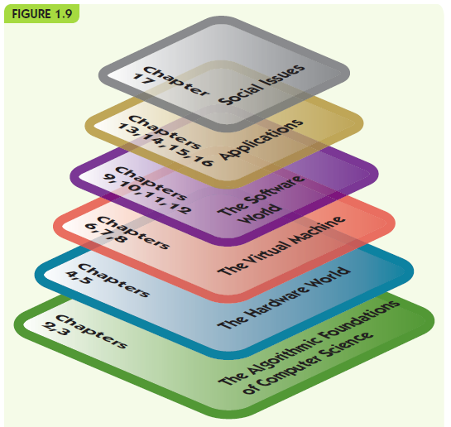

Slide 34
Summary
Computer science is the study of algorithms
An algorithm is a well-ordered collection of unambiguous and effectively computable operations that, when executed, produces a result and halts in a finite amount of time
If we can specify an algorithm to solve a problem, then we can automate its solution
Computers developed from mechanical calculating devices to modern electronic marvels of miniaturization

